Slide 1

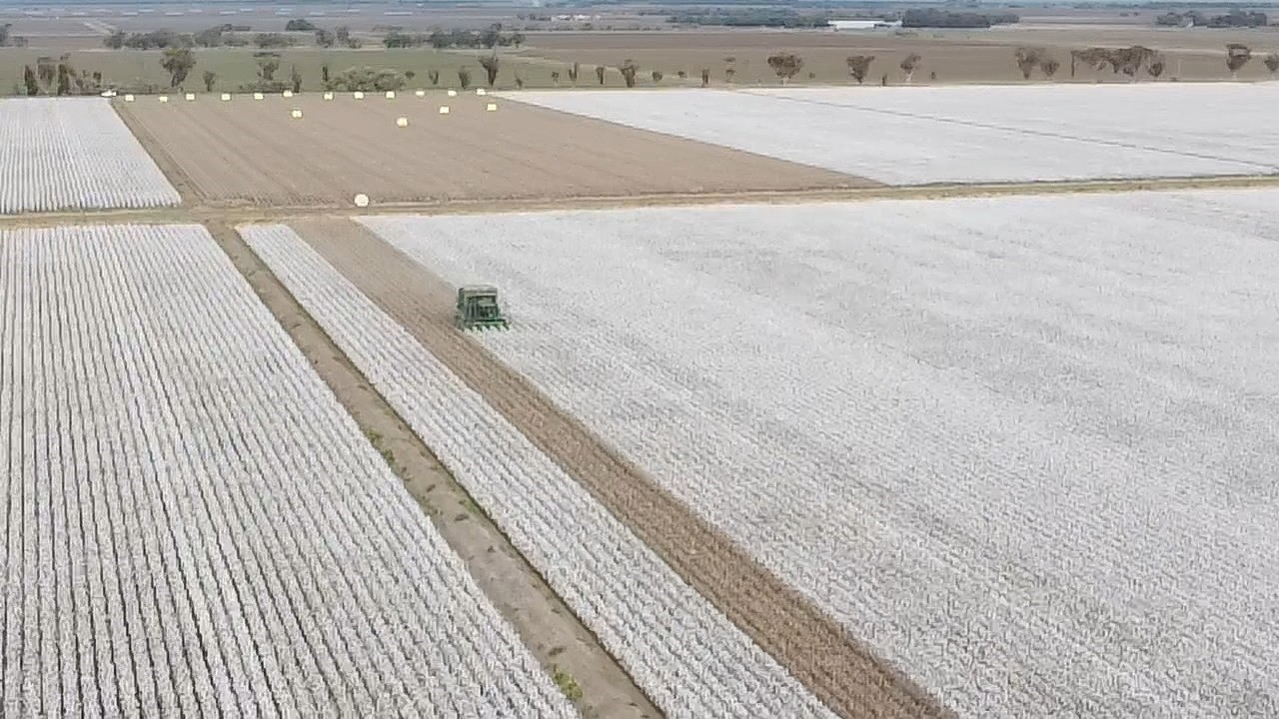

The Southern NSW Cotton survey
2025/26 season
Kieran O’Keeffe
Regional Extension Officer
CottonInfo Southern NSW
Notes:
This is a summary of a survey sent to southern growers and advisors in June and July 2025.
Area of survey was 9,928 ha.
Thanks to the growers and consultants that have contributed this year. It provides a good recap of the season and where lessons can be learnt.
If you have any suggestions for questions to include just let me know.

Slide 2
CottonInfo accepts no responsibility for the accuracy or completeness of any material contained in this publication. Additionally, CottonInfo disclaims all liability to any person in respect of anything, and of the consequences of anything, done or omitted to be done by any such person in reliance, whether wholly or partly, on any information contained in this publication. Material included in this publication is made available on the understanding that CottonInfo is not providing professional advice. If you intend to rely on any information provided in this publication, you should obtain your own appropriate professional advice.
Notes:
CottonInfo accepts no responsibility for the accuracy or completeness of any material contained in this publication. Additionally, CottonInfo disclaims all liability to any person in respect of anything, and of the consequences of anything, done or omitted to be done by any such person in reliance, whether wholly or partly, on any information contained in this publication. Material included in this publication is made available on the understanding that CottonInfo is not providing professional advice. If you intend to rely on any information provided in this publication, you should obtain your own appropriate professional advice.

Slide 3

Area of cotton 2025 -26. 49,316 ha.
Lachlan 11,043 ha Murrumbidgee 30,428 ha Murray 7,845 ha.
Bales produced 476,000
Southern valleys Average yield 9.7 b/ha
The survey covered 5,396 ha with an average yield of 10.9 b/ha

Slide 4
A few comments after pulling the survey together.
Budget on using at least 10 ML/ha
Pre irrigate some fields where possible
Use soil temperature readings and forecasts to start and stop planting.
Make sure you include all variable costs in gross margins. Budget on producing 10 b/ha
Problem weeds – control possible with XtendFlex technology
Disease is an ongoing issue, and long-term rotation choices are needed for sustainable cotton production.
Disease samples need to be sent to pathologists

Slide 5
Comments on the season
A challenging season in each part of the growing season, quite rewarding for some but quite harsh for others.
A pleasing result in a tough season i.e. Cool start and extreme extended hot period (45oC + for 10 days)
The result was disappointing, the heat in January had a large influence on the crop.
Happy with the result considering some harsh conditions. Biggest hit for us was the wind in November, otherwise crop seemed to handle the cooler start and the hot period in summer pretty well
See below
Notes:
Hot dry summer meaning no spray drift. We had good water flows consistently with backup from our dam 40 ML/day
Input prices have gone up and lint price has decreased causing a strain on margins.
The usual October planting period had only a handful of good opportunistic planting days that weren’t too cold, these fields were noticeable compared to those that had to deal with cold soil temps. Seed Germ was mixed, we rejected some cool germ 761 seed that was 69% cool germ - we didn’t want it anywhere near the farm… Small seeded varieties suffered in general across the board. The 8 days of 40+ degree weather did hurt us. Middle third of crop canopies had a lot of small, parrot-beaked bolls. 606 still showed it can be an extraordinary variety.
Some areas of poor germination and early season vigour directly affected yield
Happy considering cold start and major landforming
Poor start, seed germ on 761 terrible with average plant stand of 7/m responded well luckily on ground that is 2 crops in for a 13.1bale average , 746 still stand out performer small bolls but was loaded

Slide 6
Notes:
229 1532 Day degrees Oct- Nov 2025 indicated an average start with average potential
Data from CSD Day degree calculator.
CSD Tools | DDC

Slide 7
Day degrees Griffith 2025/26
Notes:
Note the low day degree accumulation during the November period, compared with the 10-year average, and the high accumulation from late January.
Data from CSD Day degree calculator.
CSD Tools | DDC

Slide 8
GRIFFITH AIRPORT AWS, NSW |  | 1 Oct -31 March
 | 2025 - 2026 | 2024 - 2025 | 2023 - 2024 | 2022 - 2023 | 10 year mean
DD1532* | 1292.2 | 1386.6 | 1235.6 | 900.9 | 1200.2
Cold Shock Day (≤11°C) | 41 | 32 | 51 | 59 | 43
Days above 35°C | 51 | 57 | 42 | 29 | 40
Days above 40°C | 15 | 7 | 5 | 3 | 9
Total Rainfall (mm) | 91.6 | 137 | 286.6 | 351.8 | 223.9
Total radiation (MJ/m²) | 4351.2 | 4472.1 | 4323.5 | 4187.6 | 4291.4
Average temperature (°C) | 23.6 | 24.3 | 23 | 20.7 | 22.9
Notes:
Lowest rainfall in last 10 years
Data from CSD Day degree calculator.
CSD Tools | DDC

Slide 9
Notes:
Farm average of the survey was 11.6 b/ha.
Southern valleys average is estimated at 9.7 b/ha.
Crop 1 was from the upper Lachlan.

Slide 10
Highest yielding field varieties.
Notes:
Small data set

Slide 11
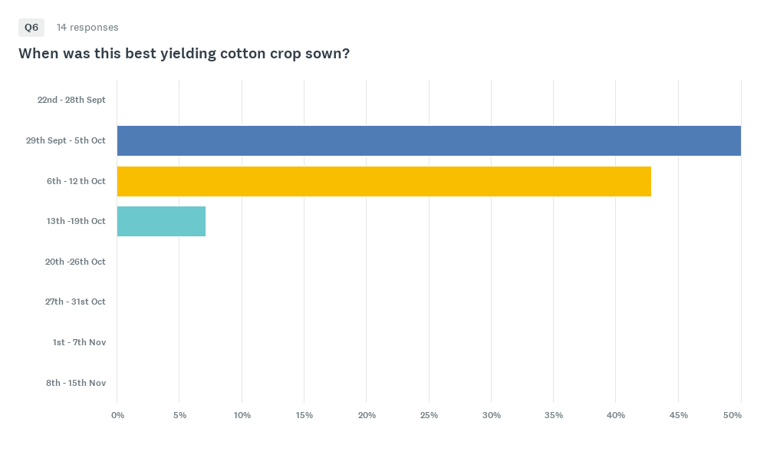
Notes:
Best fields planted in first two weeks of October.

Slide 12
To what do you attribute the success of this field (consider things within your control)?
Good ground prep and rotation. Carrying out operations on time.
Soil prep was good which helped with fast germination and good field layout enabled timely irrigations during heat
Soil moisture monitoring during heatwave, foliar fert program.
Pre-irrigating and 619 variety having better vigour to handle the cold in October and wind in November.
See below
Notes:
Good establishment, watering on time, good water flows
Hill prep and planting conditions were optimised, we were very lucky to have a run of ‘okay’ and semi-warm days for the 1st 5d post watering, before it got cool again into the second week of October. We watered field to crop demand, same with nutrition. The variety we planted was spot on, we got by with skin of our teeth at planting (71% cool germ seed, so took a huge risk). A shame we won’t see something like 606 in years to come.
Heavy black soil type backing onto river, cracks open and deep between irrigations but doesn’t dry back and will Hold on, on longer irrigation interval
Early preparation, very even singulation from the planter. Well timed irrigations.
Even establishment Variety Disease absence
Uniform plants, water scheduling
Got water on and off quickly
Variable rate gypsum Variable rate Granulok Z Luck
not sure

Slide 13
Q9: Please indicate planting conditions with respect to moisture.
Answered: 14 Skipped: 1

Slide 14
Gross margins 2026 (averages)
Total Income/ha $ 8174
Variable cost/ha $ 5242
Gross margin/ha $ 2932
GM/ML $ 293
Average water use 10 ML/ha

Slide 15
Southern NSW Gross margins Long term average
 | Income /ha | Variable costs /ha | GM/ha | GM/ML
Long term Average | $6,929 | $3,797 | $3,004 | $300
2026 | $8,174 | $5,242 | $2,932 | $293
% OF LTA | 117% | 138% | 97% | 98%
Notes:
This is a small data set so does not reflect overall financial performance across the valleys.
A significant increase in reported variable costs would include water costs
Above figures uses Long term average water use of 10ML/ha.

Slide 16
Nitrogen Fertiliser Use Efficiency
NFUE - Rule of thumb – research asks to aim for 13 – 18 kg lint/unit N.
More N does not always = more yield. Many factors determine yield. There has been a trend of lower applied N over the last few years.
If your below 10 kg lint/unit N a soil constraint needs to be addressed, or irrigation management needs to be assessed.
Notes:
This measure is a rough guide to efficiency as starting N and mineralisation are not accounted for.
There has been an increase in pre crop soil testing and factoring in soil N at the start

Slide 17
Crop | Yield (b/ha) | Pre N | Planting N | In crop N | Total N applied | Kg Lint/N
1. | 16.2 | 200 | 5 | 28 | 233 | 15.8
2 | 14.36 | 119 | - | 79 | 198 | 16.4
3. | 14.3 | 20 | - | 230 | 250 | 13.0
4. | 13.8 | - | - | 260 | 260 | 12.0
5. | 13.5 | 150 | - | 100 | 250 | 12.3
6. | 13.33 | - | 138 | 140 | 278 | 10.88
7. | 12.76 | - | 235 | 85 | 320 | 9.05
8. | 12.5 | - | - | 300 | 300 | 9.46
9. | 12.4 | - | - | 138 | 138 | 20.4
10. | 12.3 | - | 158 | 147 | 305 | 9.15
Ave | 13.5 |  |  |  | 260 | 11.79
Notes:
Nitrogen Fertiliser use efficiency - top ten fields in the survey averaged 11.79 kg Lint/kgN.
In 2013/2014 the average was 11.4 kg Lint/N,
2014/2015 13 kg Lint/N,
2015/2016 13.4 kg Lint/N,
2016/2017 10.6 kg lint/N,
2017/18 11.85 kg lint/N
2018/19 9.65 kg lint/N
2022/23 14.2 kg lint/N
2023/24 13.1 kg lint/N
2024/25 15.5 kg lint/N

Slide 18

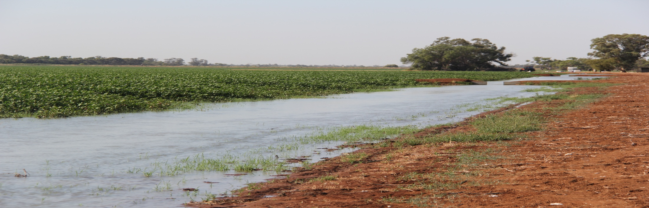
Water use
Water use varied from 8 ML/ha to 11 ML/ha
Average was 10 ML/ha
Notes:
Long term average of surveys is 10 ML/ha

Slide 19
Crop | Yield (b/ha) | IRRIGATION System | ML applied # Estimated | Bales/ML
1 | 16.2 | Pontoon 1m hills | 9 | 1.8
2 | 14.36 | Bankless 1m hills | 10 | 1.4
3 | 14.3 | 1m Hills , syphon lay out 0.07 grade | 11 | 1.3
4 | 13.8 | 1m hills, bankless | 11 | 1.25
5 | 13.5 | 1m hills, pontoons | 11 | 1.23
6 | 13.33 | 1m hills / flat bays | 10.5 | 1.27
7 | 12.76 | 1.8 Metre beds. 1:2500 (.04) 90 cm | 10 | 1.28
8 | 12.5 | 6ft beds Zero grade 36inch 91.5cm | 11 | 1.14
9 | 12.4 | 6ft beds 36" spacing | 8 | 1.55
10 | 12.3 | Siphon, 1m hills | 8.6 | 1.43
Notes:
Data from ten highest yielding crops in survey with full data sets.
Average for 2025/2026 was 1.37 bales/ML.
Long term average is 1.43 bales/ML
2024/25 was 1.66 ba/ML
2023/24 was 1.75 ba/ML
2022/23 was 1.38 ba/ML
2018/19 at 1.18 ba/ML
2017/18 at 1.47 ba/ML
2016/17 at 1.32 ba/ML
2015/16 at 1.61 ba/ML
2014/15 at 1.51 ba/ML
2013/14 at 1.01 ba/ML

Slide 20
Crop | Yield (b/ha) | Mepiquat chloride management
1 | 16.2 | 23 January 50 ml/ha, 2 Feb 170 ml/ha
2 | 14.36 | 5mL RX380 with an OTT pass 29th Dec VR 15mL/0ml Jan 15th 200ml Blanket Feb 4th
3 | 14.3 | 25ml RX380 13/1 300ml Rx380 Cut out pass 23/1
4 | 13.8 | 21st Jan, 150ml rx380
5 | 13.5 | 20ml of RX380 applied Jan 5th. 200ml applied Feb 4th to cut the crop out. white flower was ahead of where we wanted it due to extreme heat in January.

Slide 21
Crop | Yield (b/ha) | Mepiquat chloride management
6 | 13.33 | 1 cutout rate 21/1/26 - 300ml/ha
7 | 12.76 | 200ml on 1/2
8 | 12.4 | part area check @40ml rx380 on 27/12 25/1/26 cutout Rx380 @100ml 4/2/26 2nd cutout 100ml
9 | 12.3 | 200 mL @ 5/2/26
10 | 12.1 | Variable rate, 0-.04 l/ha RX380 2/1/26 0.2 l/ha RX380 7/3/26

Slide 22
Insect issues?
Thrip pressure very high during November
Pockets of high Mirid pressure
Most crops one Mirid insecticide
Most fields had just had one or two insecticides
Comments below reflect in general a low-pressure insect year
Notes:
Relatively low. Some fields had an early season FIP for thrips, mainly those fields most BRR affected to protect Green leaf area. Transform/Primal applied for Mirids..
2 insecticides, thrips early then mites
There was low insect pressure for the season. Thrips were an issue sporadically in different places.
No insect problems one insecticide low rate applied at cut out.
2 insecticides, mostly mirids
nothing too bad 2 insecticides
Thimet Dimethoate Transform Skope
high rate of Thimet at planting got us through thrip pressure, did one application of transform (100g/ha).

Slide 23
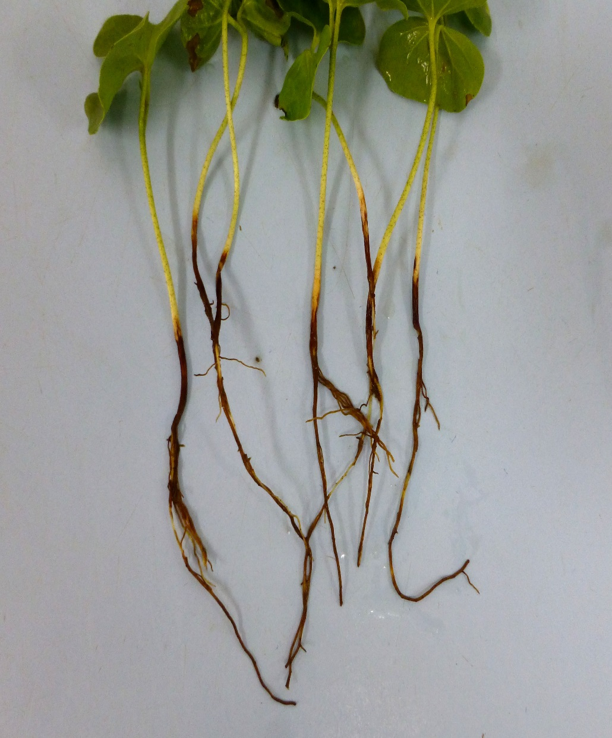
Disease comments
COME CLEAN, GO CLEAN
Starting to see more fusarium and verticillium creep in
Heavy BRR in areas. Likely 2-3b/ha yield reduction in these fields/areas.
See comments below
Notes:
Starting to see more fusarium and verticillium creep in
Cold weather in November saw significant plant losses but stands where still even stand didn't limit yield.
No disease issues
no disease issues
nothing of note
No real problems
none visible

Slide 24
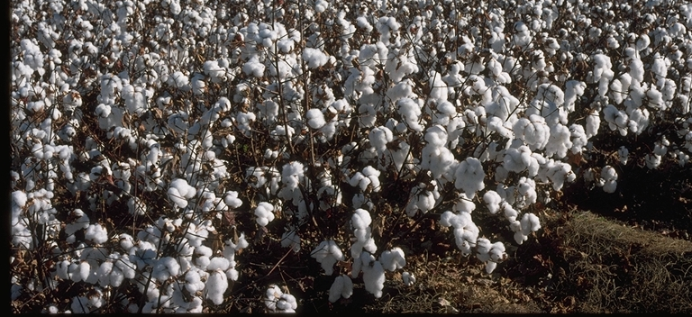
Fibre quality
See comments below
Notes:
Early picked excellent quality
Bit of High Micronaire in 761
A lot of long staple length coming out of the 619 Pockets of low mic, the drop off of last effective flower this year has been very abrupt. Tagged flowers post 18th Feb have not come to anything. Later picked fields are now coming in with 4 colour issues
I've had minimal conversations about discounts on lint this season.
good fibre quality no discounts No micronaire issues
Fibre all good on 619. still to do 746
no discount
no discount

Slide 25
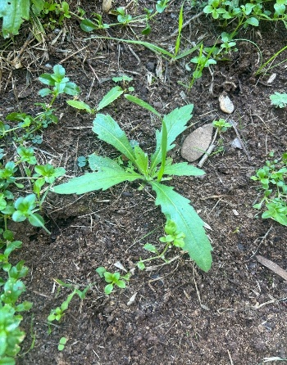
What is your main problem weed?
Ryegrass
Fleabane
Barnyard grass
Feathertop Rhodes grass
Options for all made easier with Xtendflex technology.
See comments below
Notes:
Ryegrass, Feathertop, Liberty Link/Gly Resistant canola!! Fleabane etc.
Barnyard and fleabane,
Annual ryegrass. It’s managing to germinate later and later.
Annual Ryegrass.
Resistant rye Grass & Fleabane, Burn stubble, cultivate and chemical spray
Fleabane.. Double knock in winter/spring
ryegrass fleabane nightshade
Ryegrass. Cultivation and spray
Ryegrass. double knock with gramoxone over winter when the weed is still 1-2 leaf, keeping fallow clean PSPE with dual gold and diuron

Slide 26
Biggest challenge to profitability
Water availability and affordability 💦
Growing costs rising
Black root rot
See comments below
Notes:
Access to water Cost of production
Poor seed quality. Water prices etc
Water availability and price with less water available after buybacks
Cost of production - disregard water, the cost of inputs and machinery passes is starting to really hurt.
Black root rot, water security.
Water availability and water price Cotton lint price
Water
water availability and affordability and rising input costs
Water
Water cost/availability

Slide 27
Technology changes?
Considering
Mainly focusing on soil still - lifting production in poor areas
Yes. Want to implement VR nitrogen application and more utilisation of PCT to analyse yields.
More strategic use of our drone
Notes:
Completion of irrigation automation which has proven to deliver yield increase and water savings due to better water management.
Not currently. irrigation automation in the next 10 years if it becomes more accurate/cost effective

Slide 28
Research areas /information/skills
Black root rot management
I’d like to see a bit more work on N mineralisation rates Companion planting for establishment
Better disease research with crop rotations that are more relative to our area.
Implementation of autonomous equipment and how we transition to this system.
Notes:
Root Disease, Precision ag implementation and case studies.
Seed vigour is key

Slide 29
A big thank you to all those that have provided data for this survey.
The strength of this survey comes from participation and over the years to see trends and benchmark performance.
If you have any suggestions for questions to include just let me know.
Kieran O’Keeffe, Regional Extension Officer
CottonInfo Southern NSW
M. 0427 207 406
E. Kieran.okeeffe@cottoninfo.net.au

